Slide 1
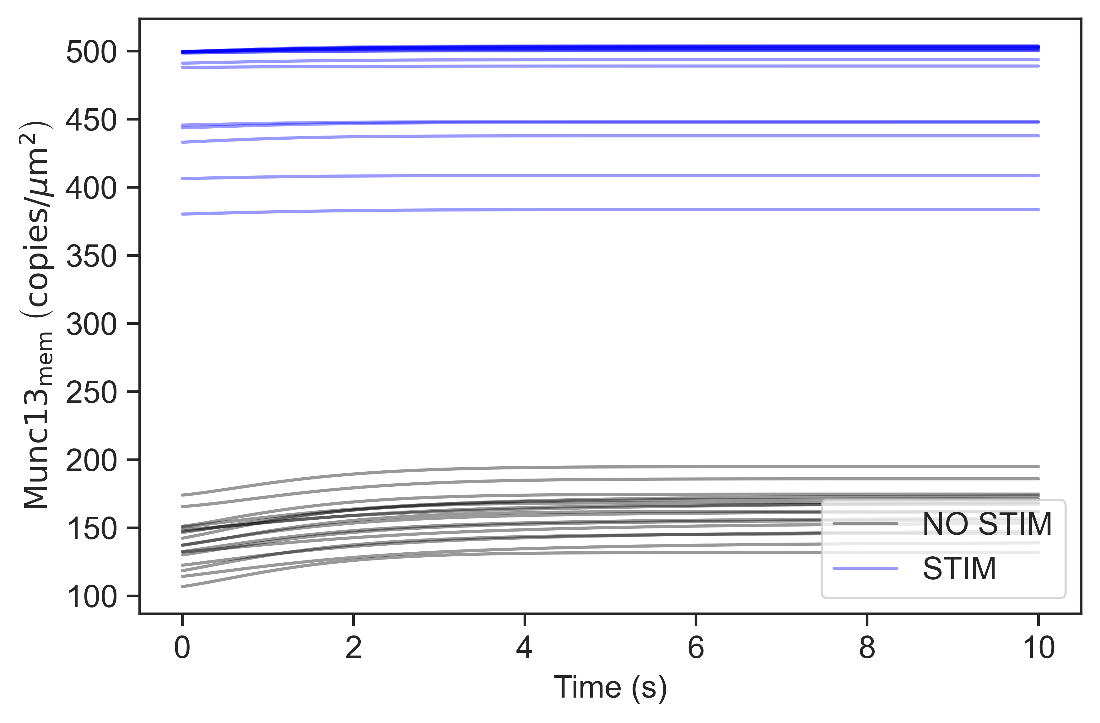
Notes:
Best 17 solutions

Slide 2
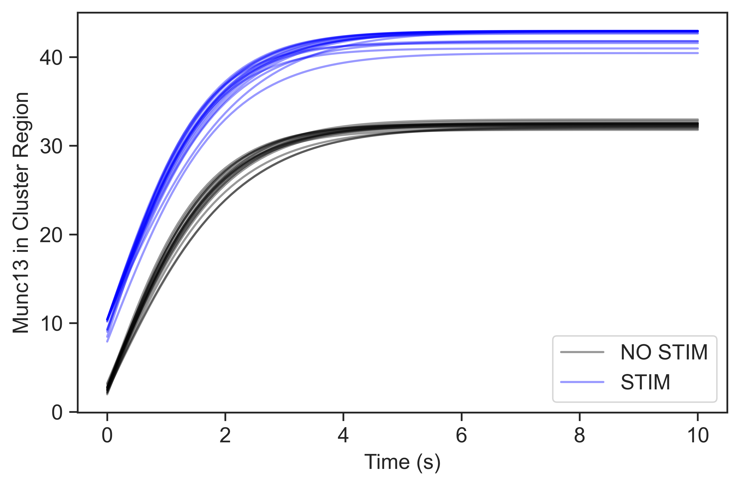
Notes:
Best 17 solutions
X is fixed at 10 copies; 5-10 X

Slide 3
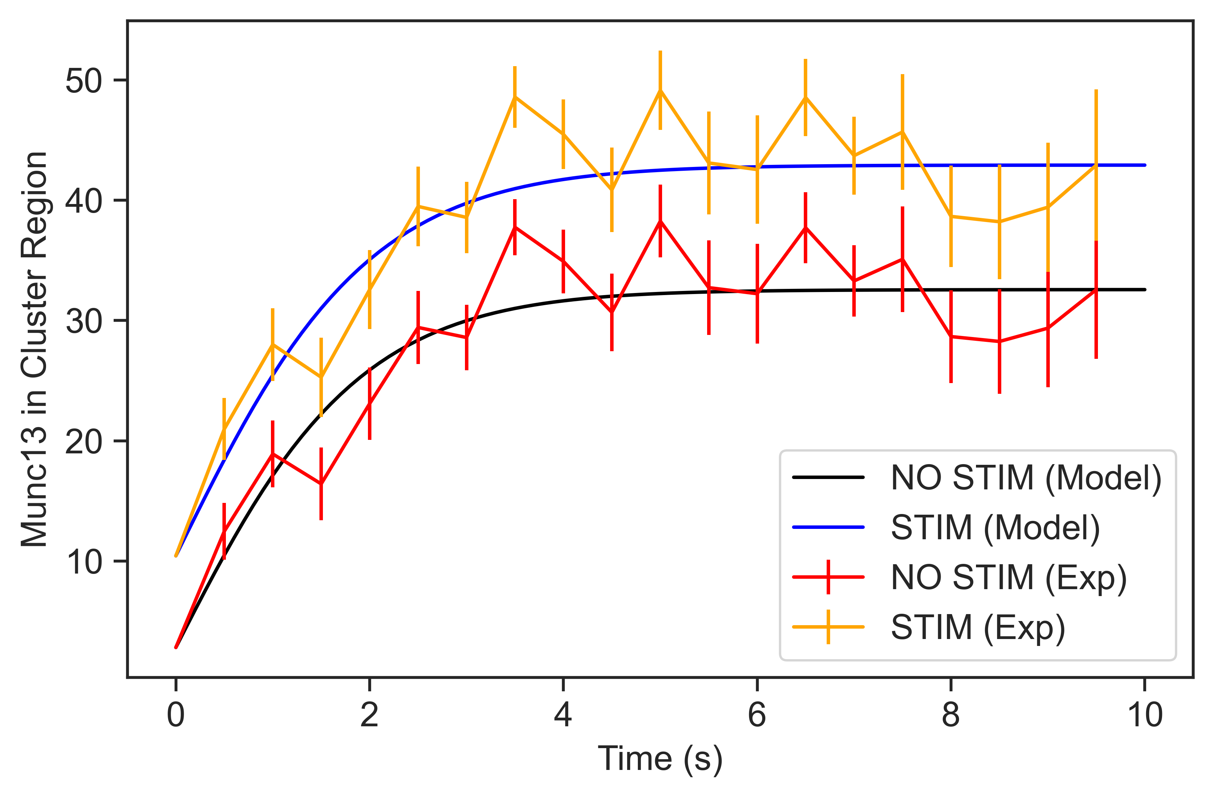
Notes:
Best solution with experimental kinetic
6%

Slide 4
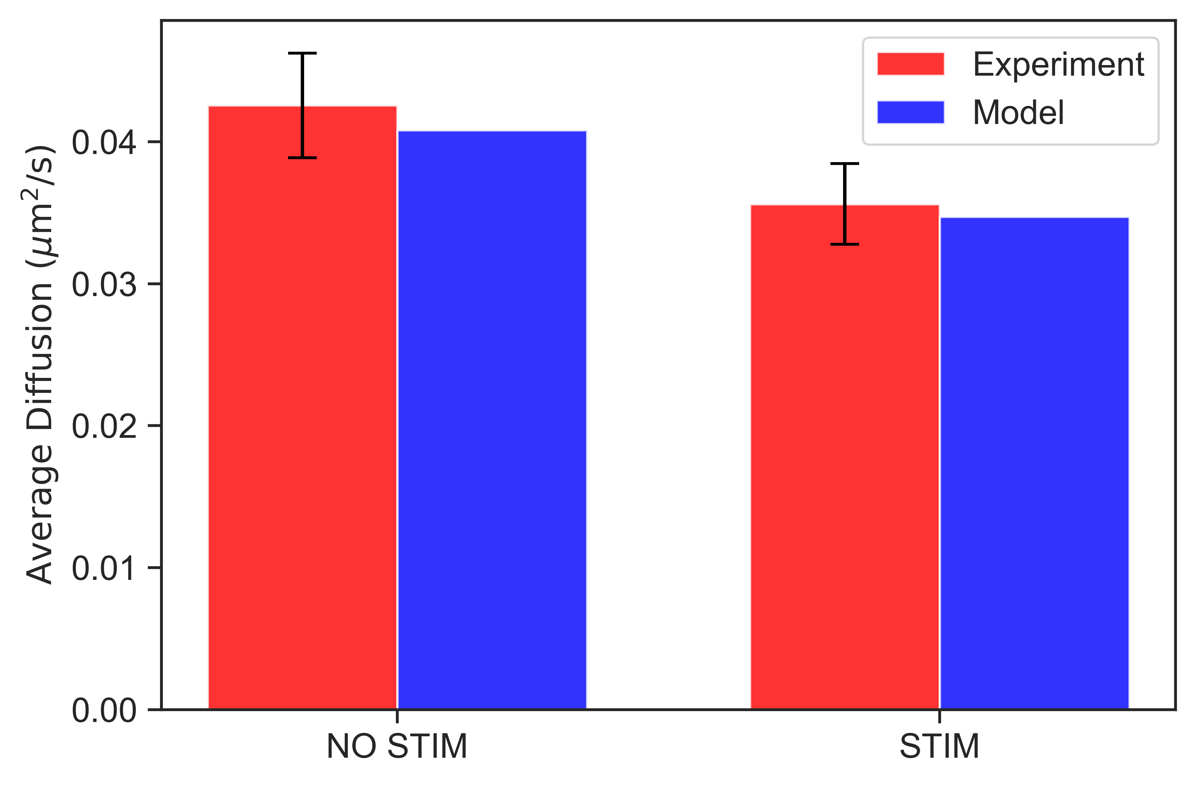
Notes:
Best solution

Slide 5
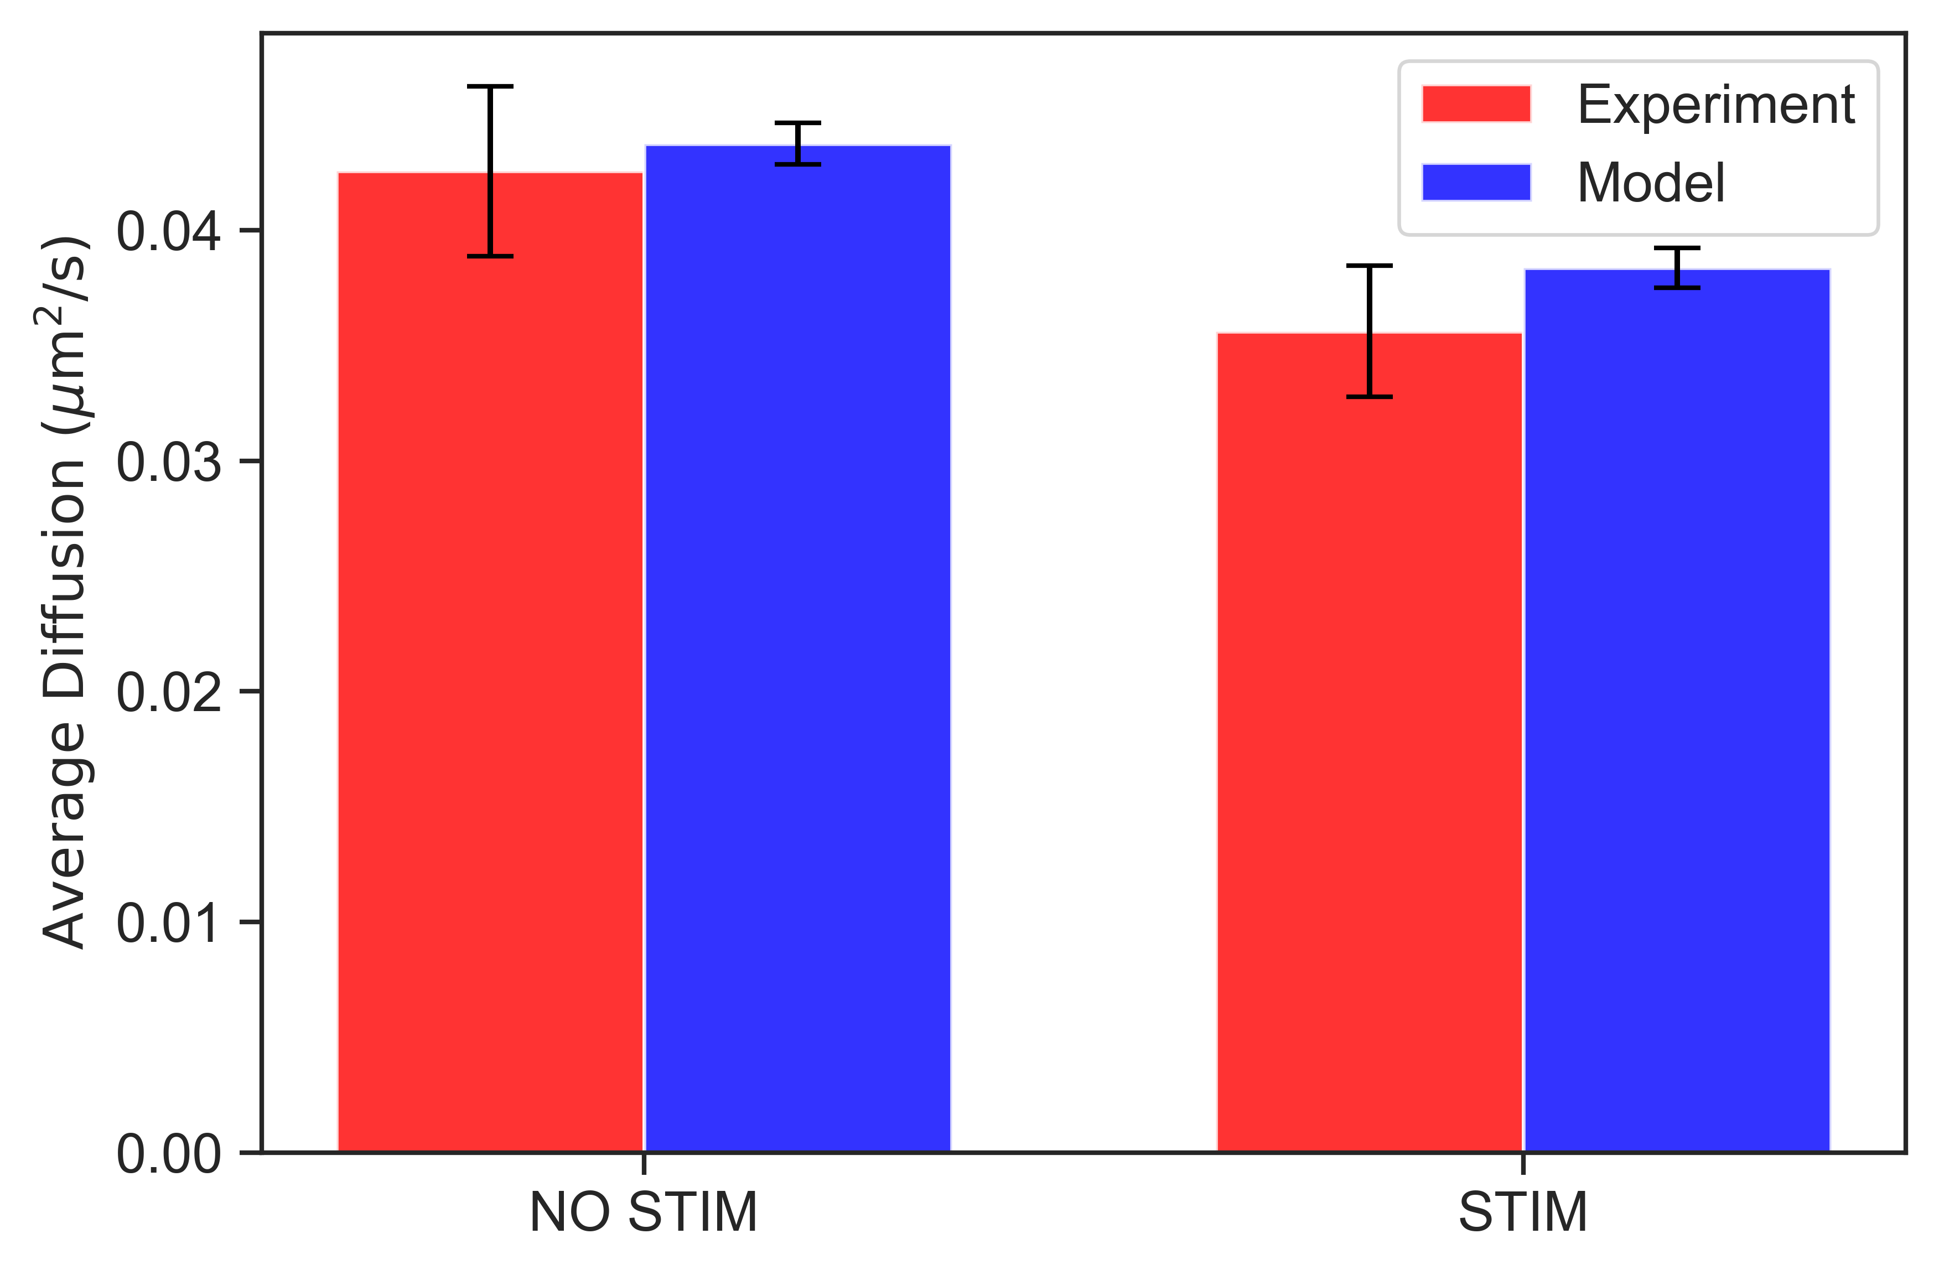
Notes:
Best 17 solutions. 17 is the count of experimental data

Slide 6
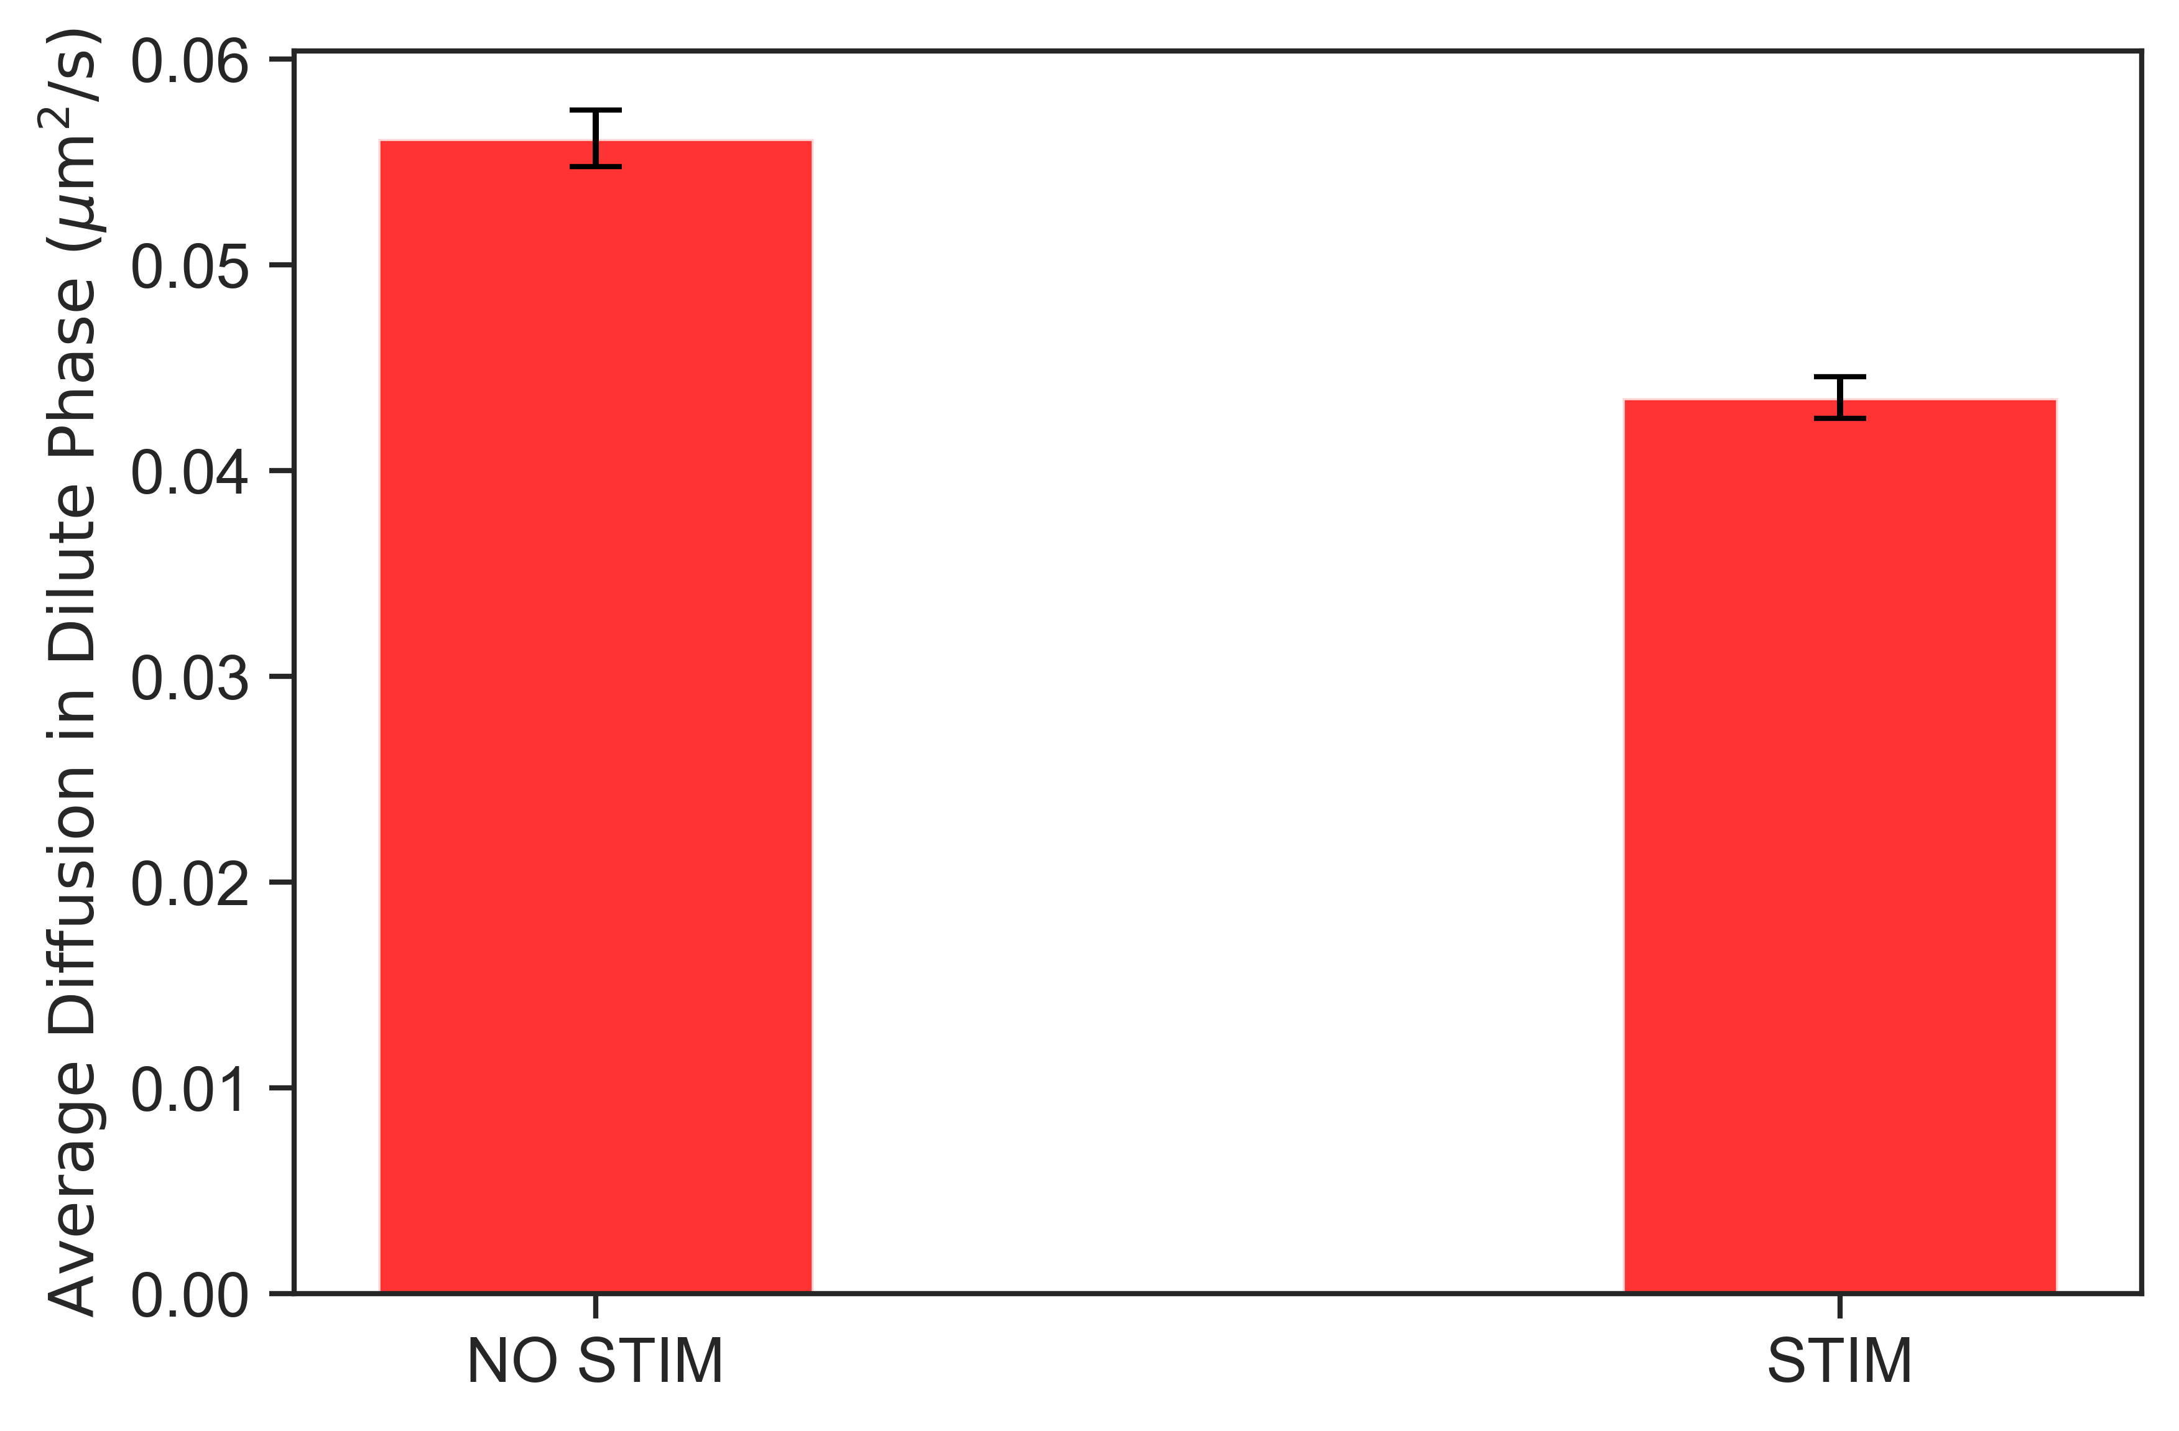
Notes:
wt

Slide 7
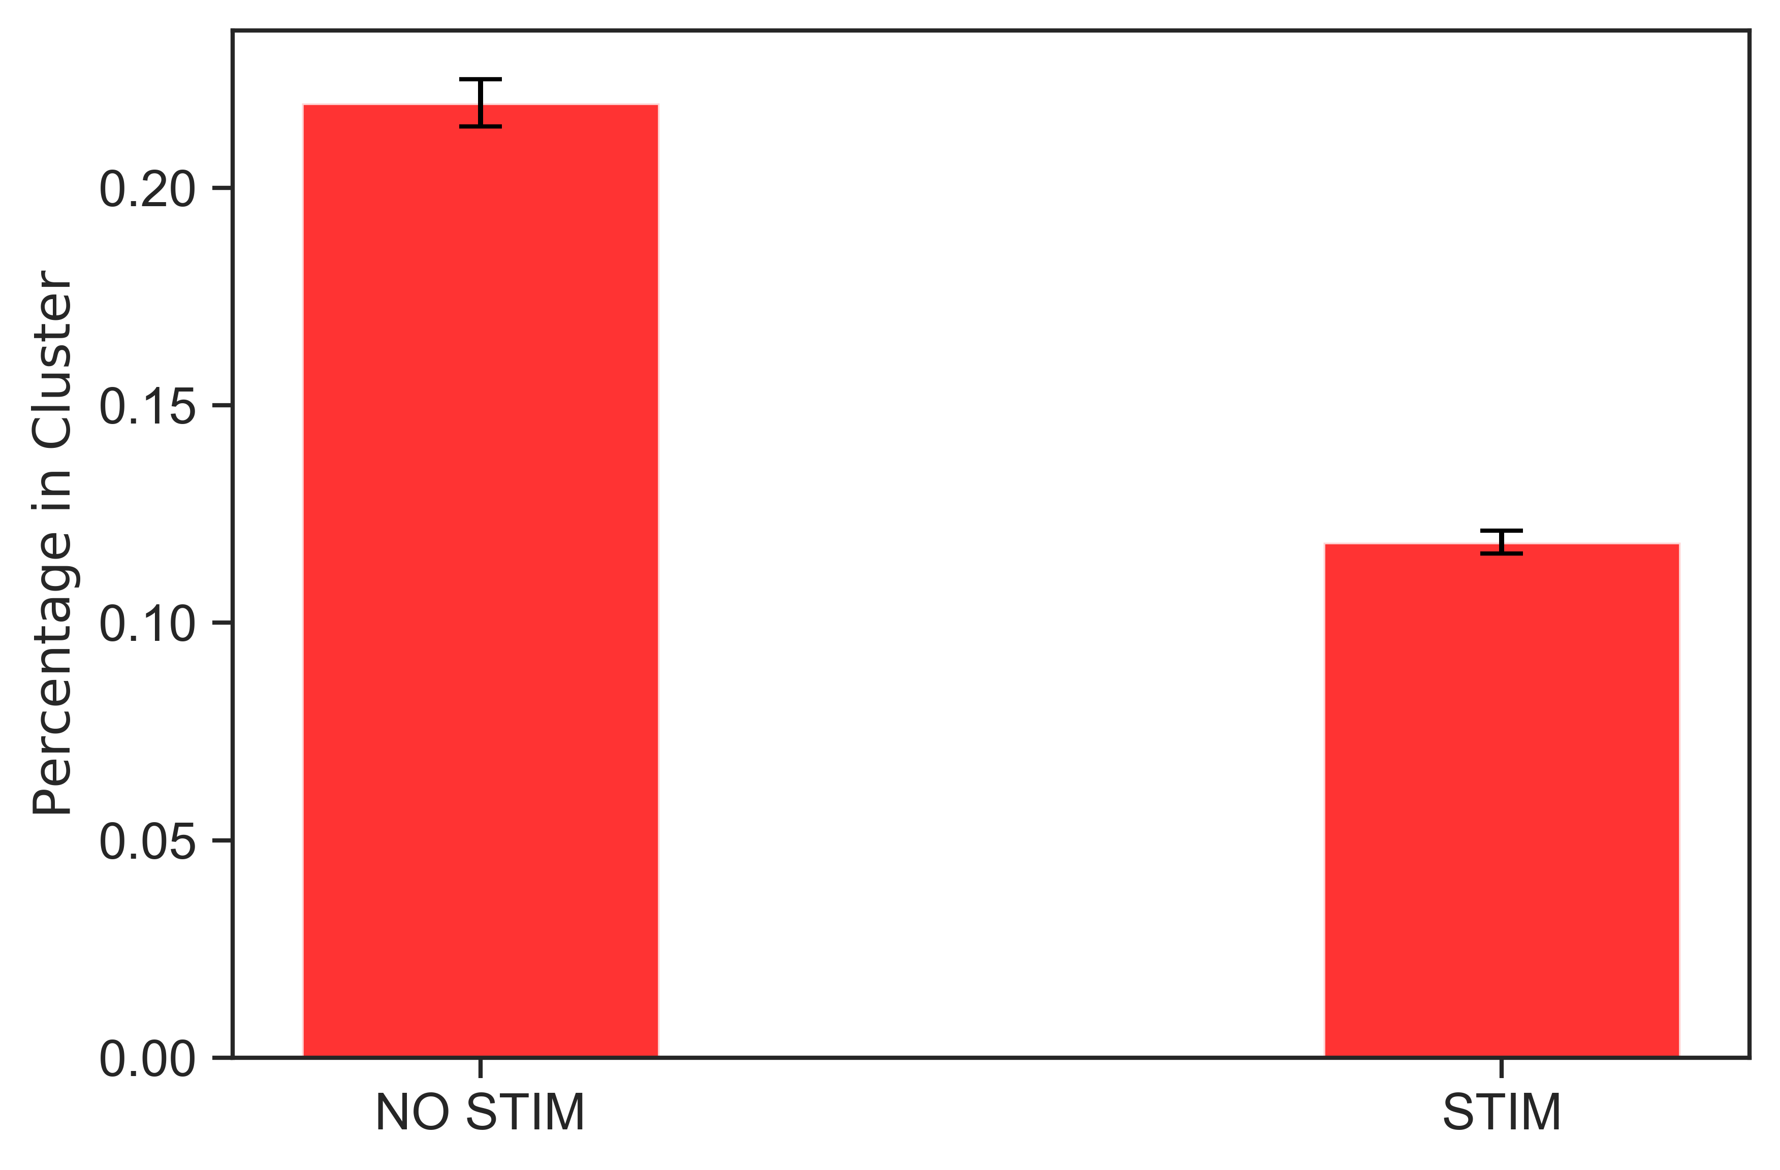
Notes:
wt

Slide 8
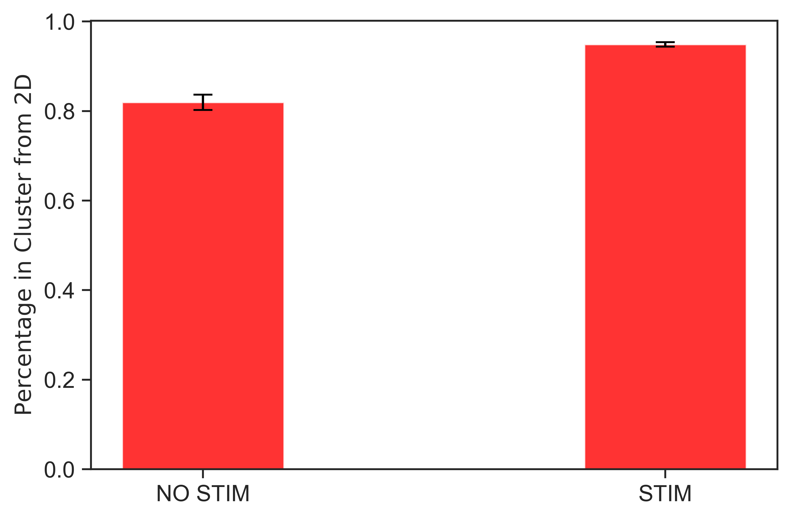
Notes:
wt

Slide 9
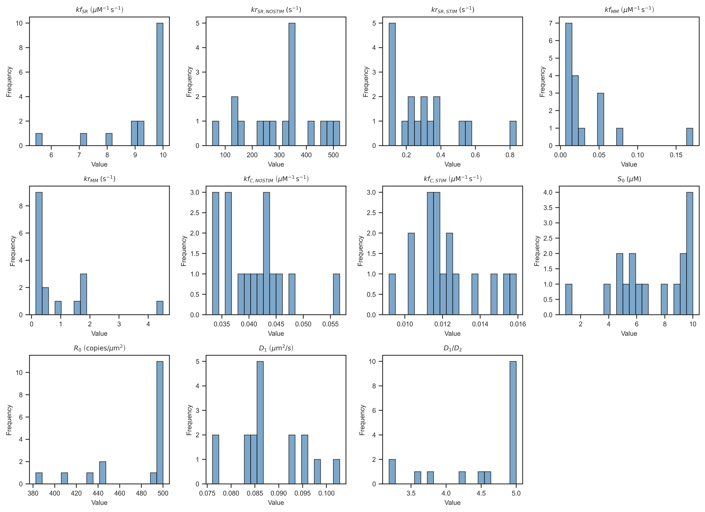

Slide 10
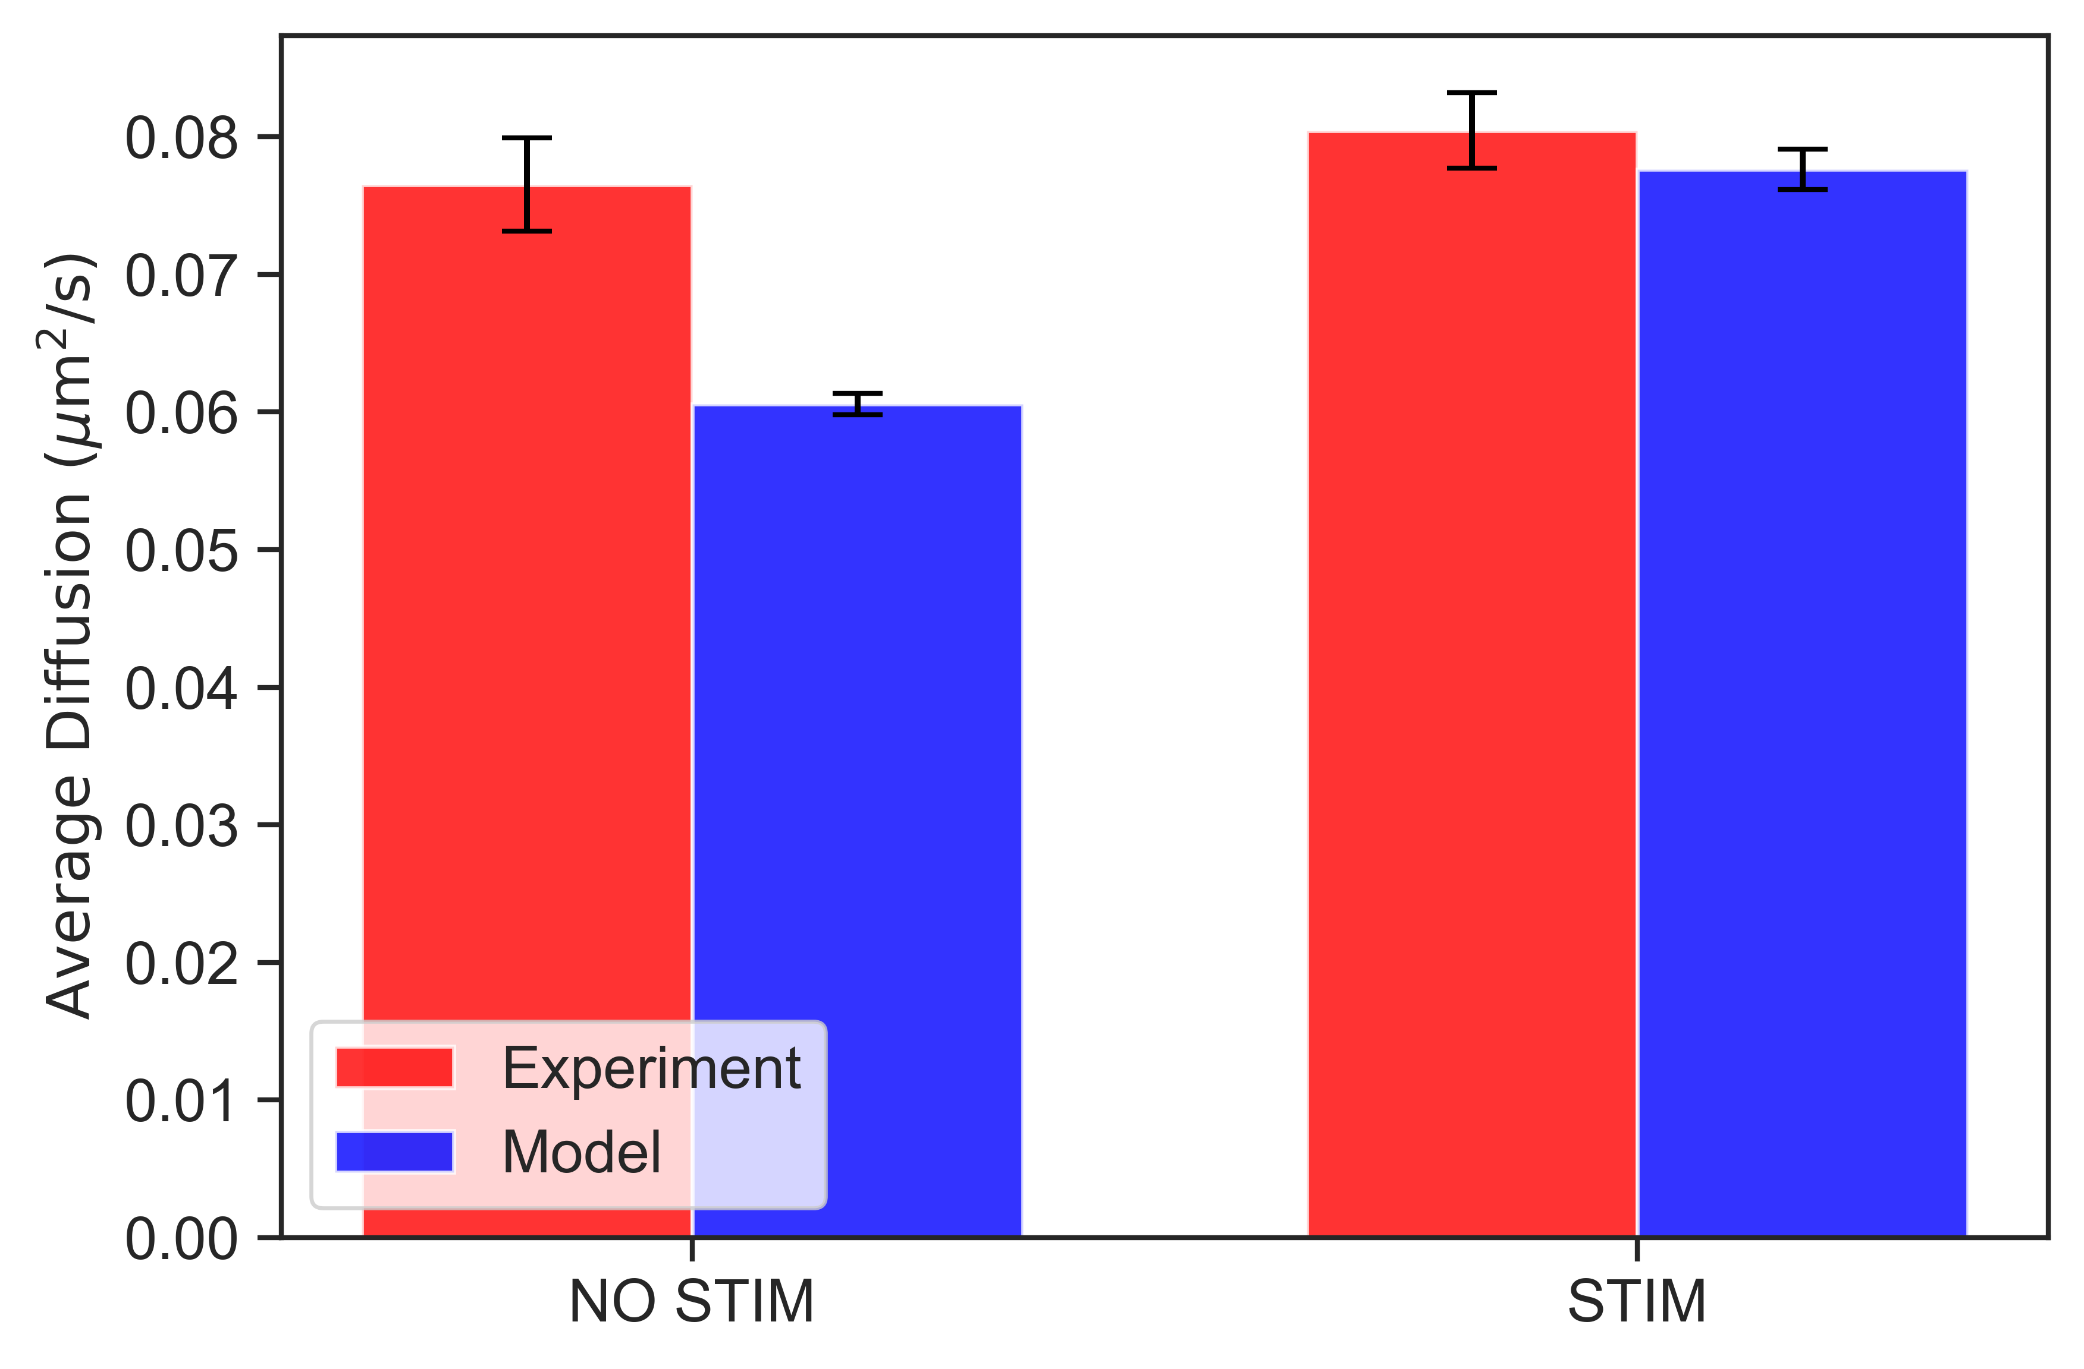
Notes:
DeltaC2A

Slide 11
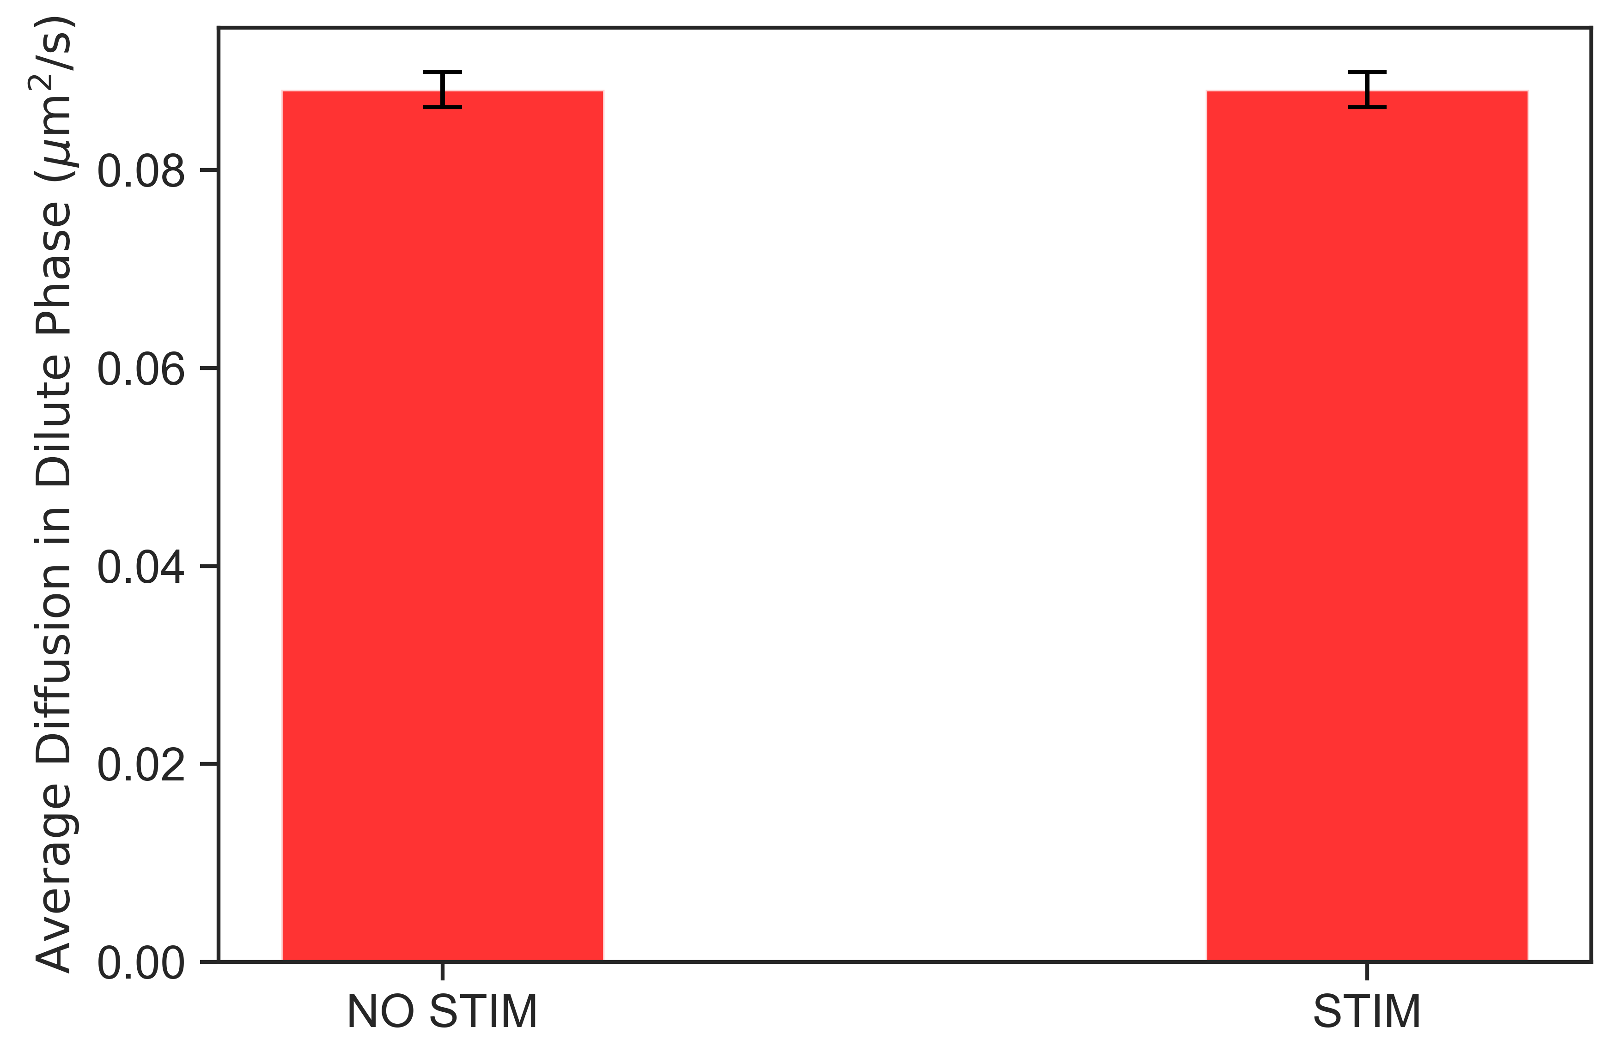
Notes:
DeltaC2A

Slide 12
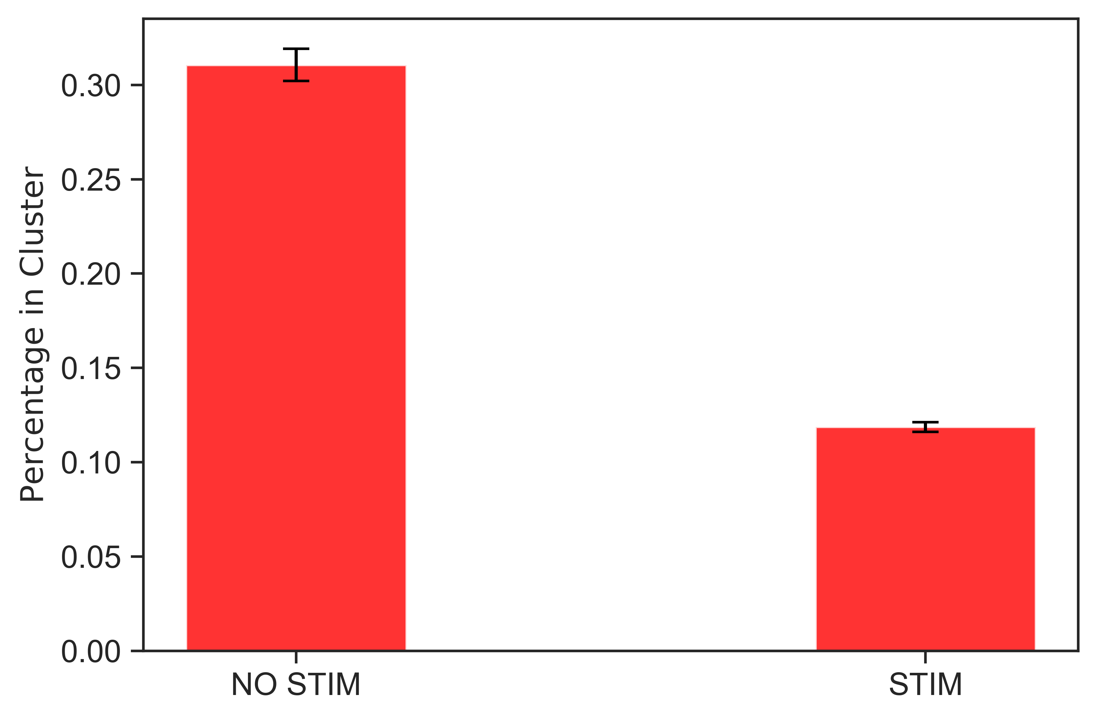
Notes:
DeltaC2A

Slide 13
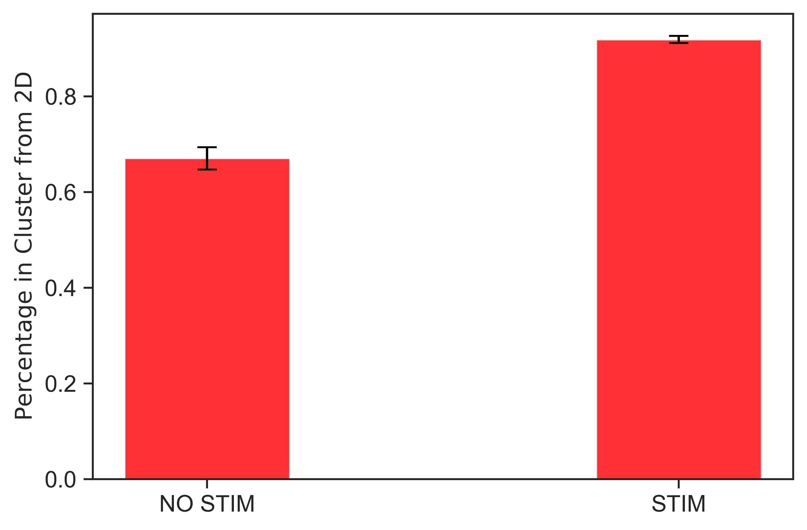
Notes:
DC2A

Slide 14
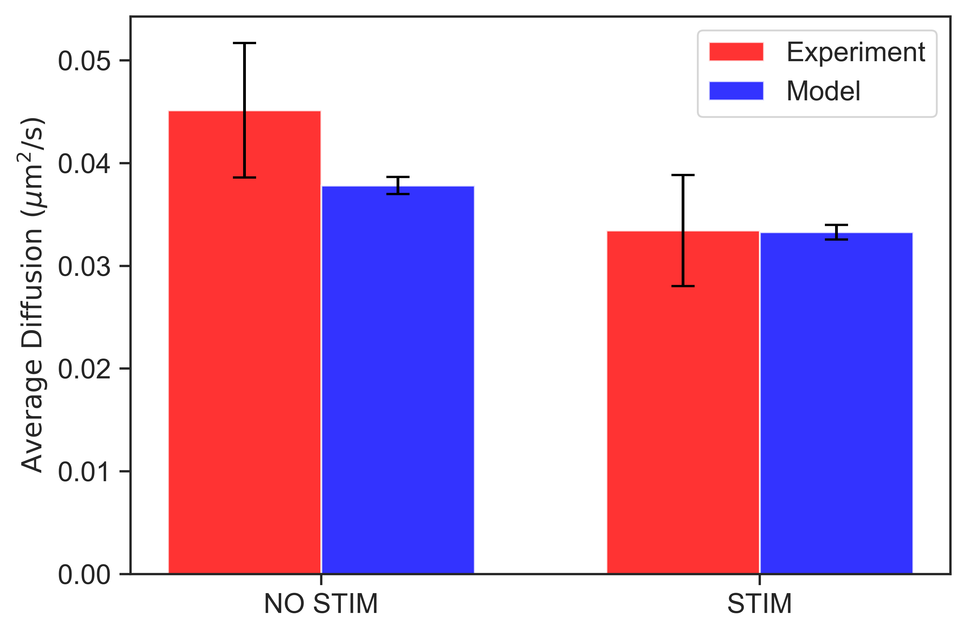
Notes:
shRIM

Slide 15
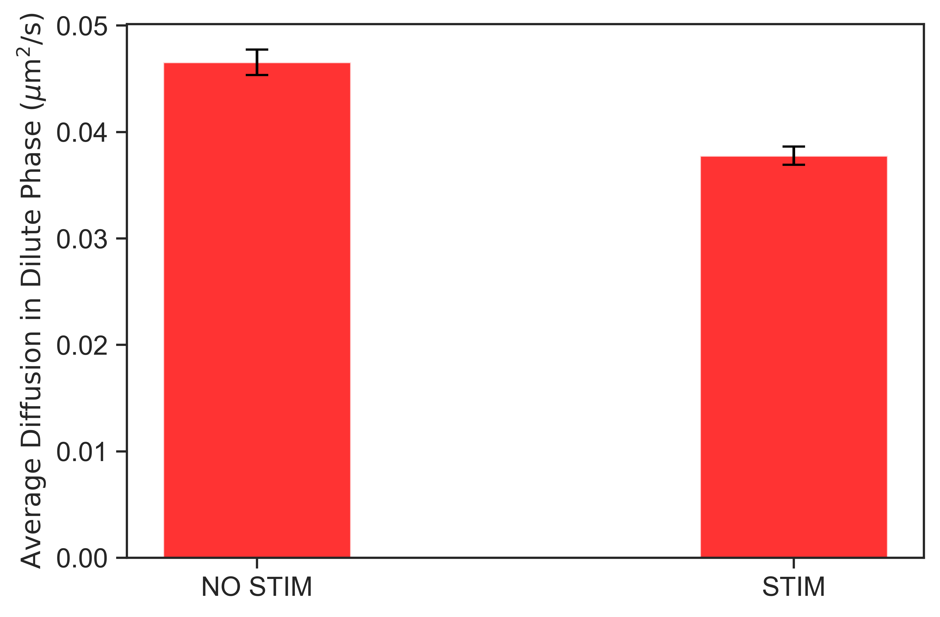
Notes:
shRIM

Slide 16
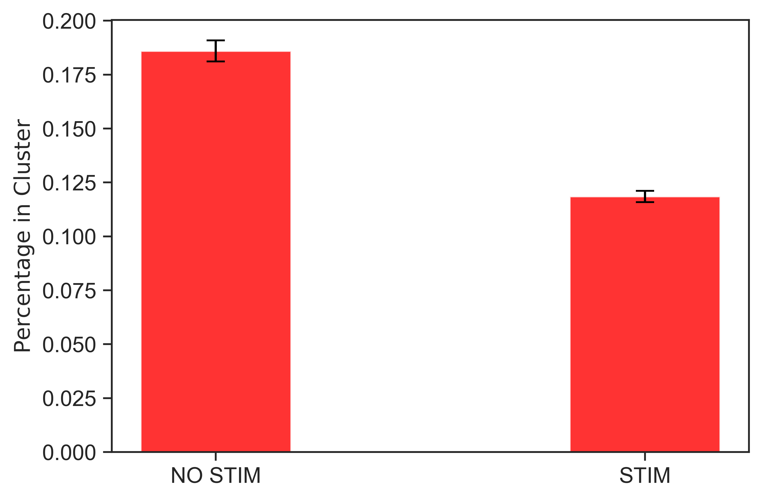
Notes:
shRIM

Slide 17
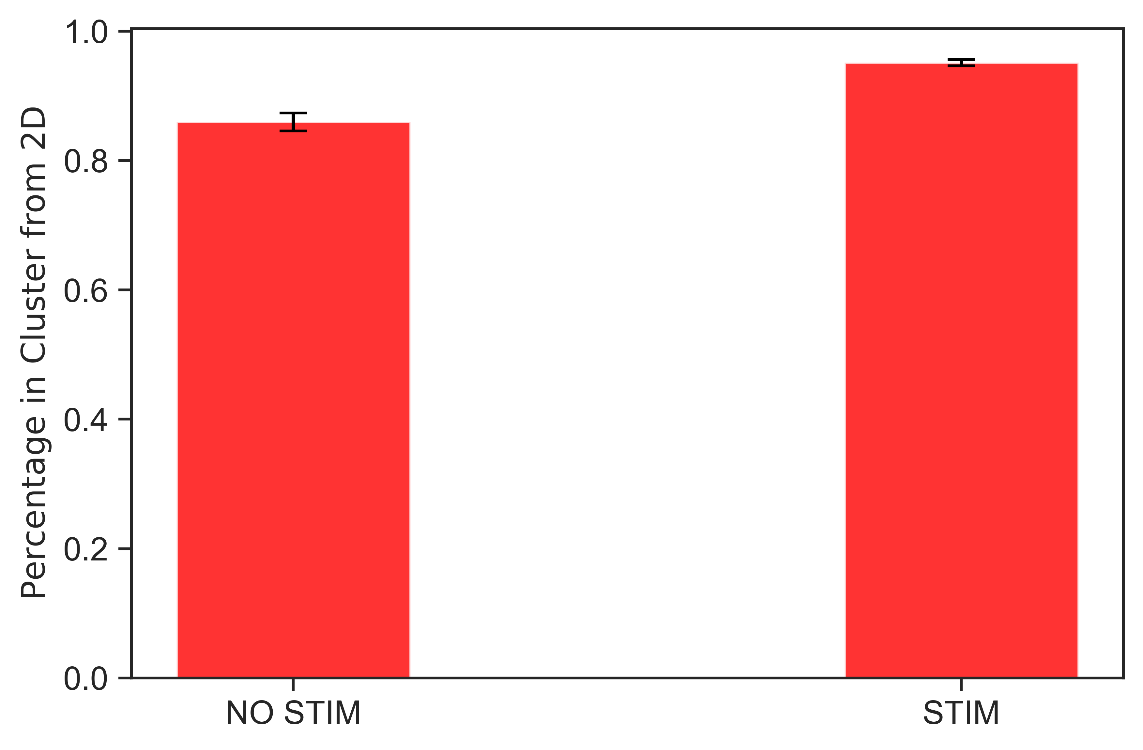
Notes:
shRIM

Slide 18
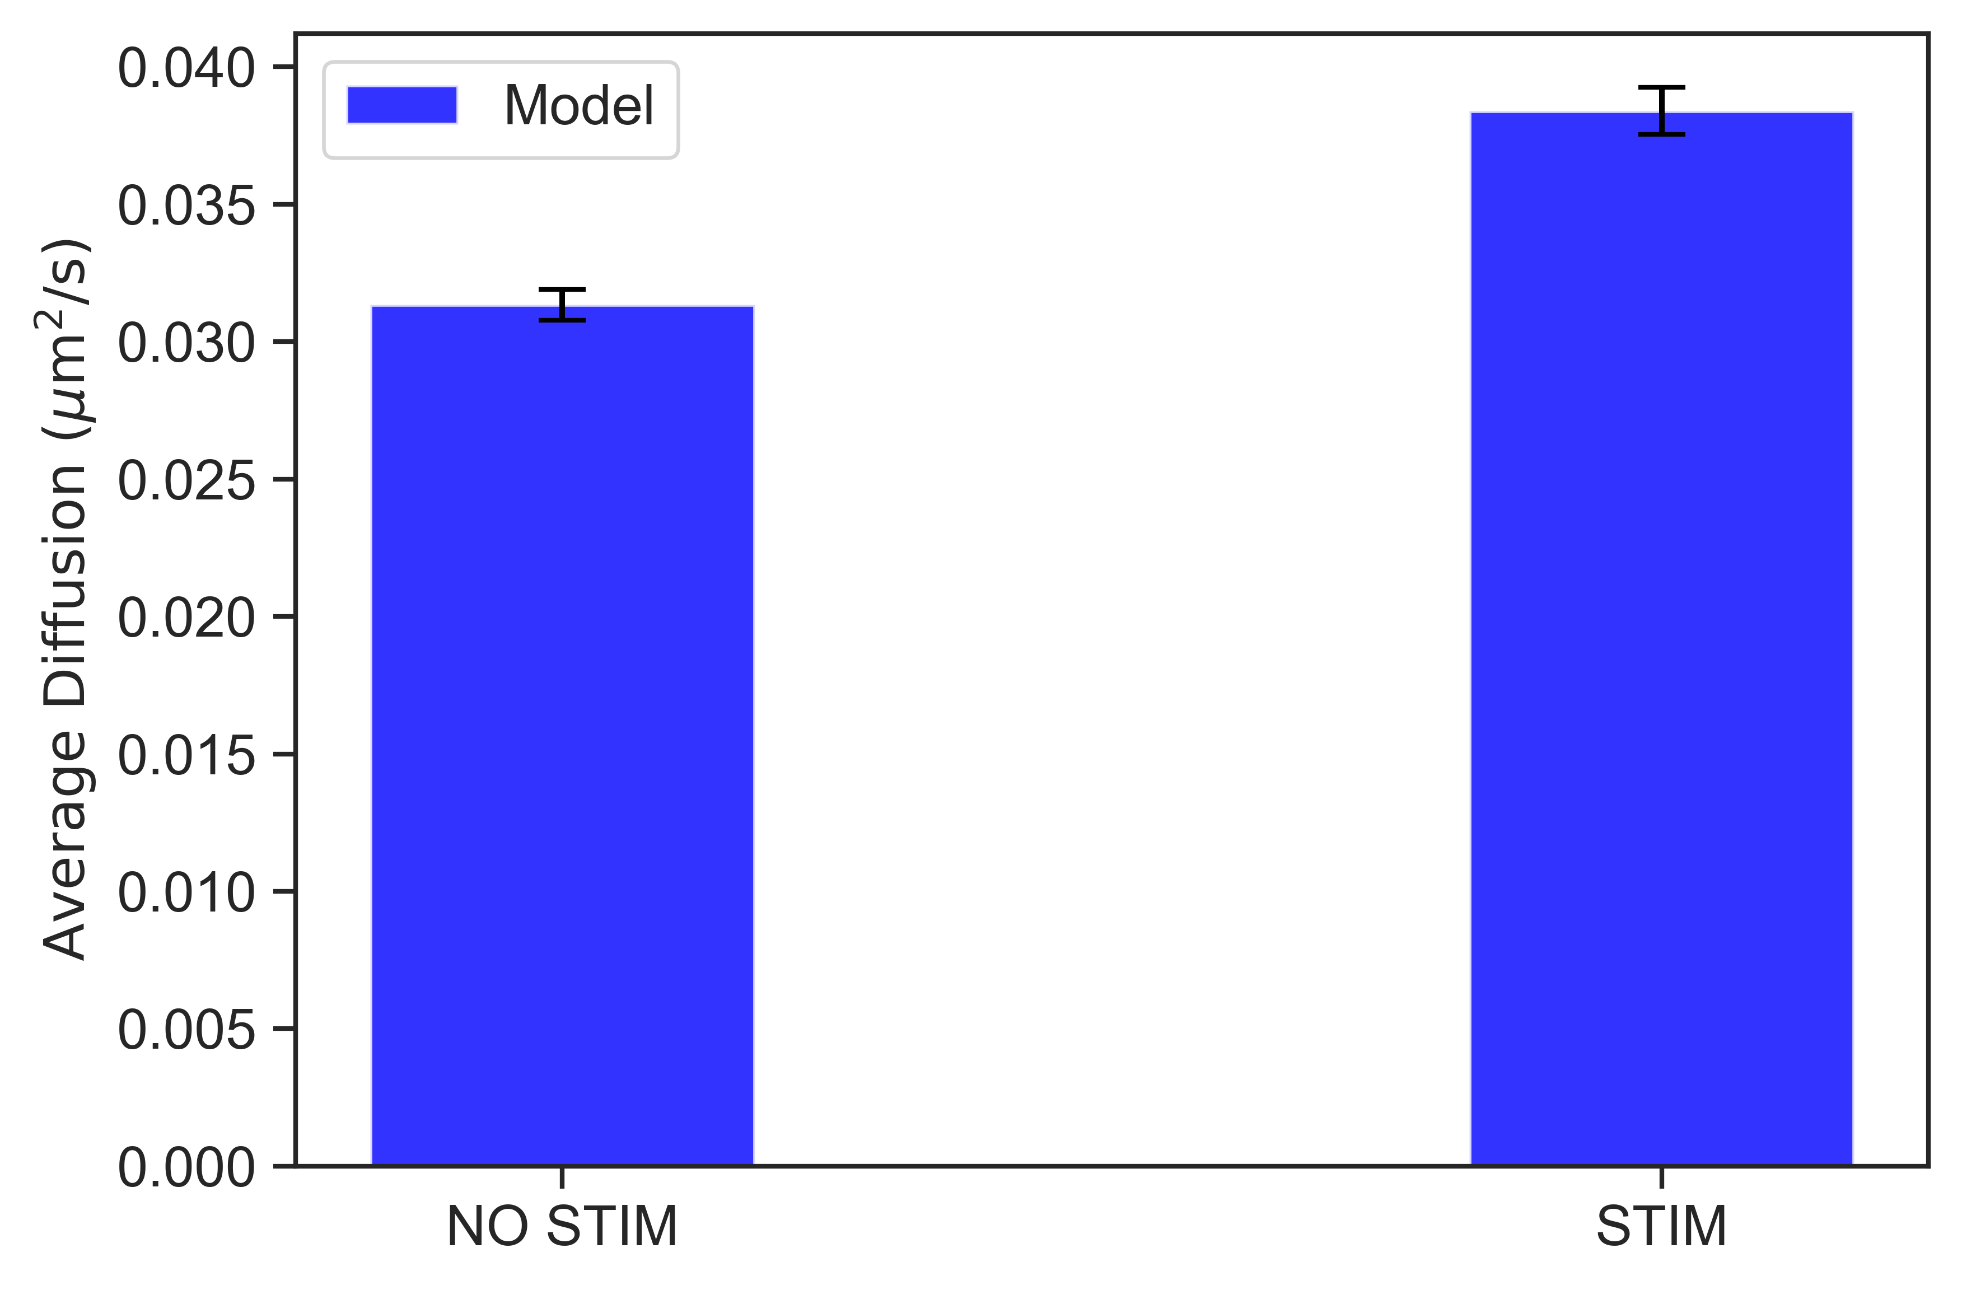
Notes:
Lower binding rate to lipid (0.2x)

Slide 19
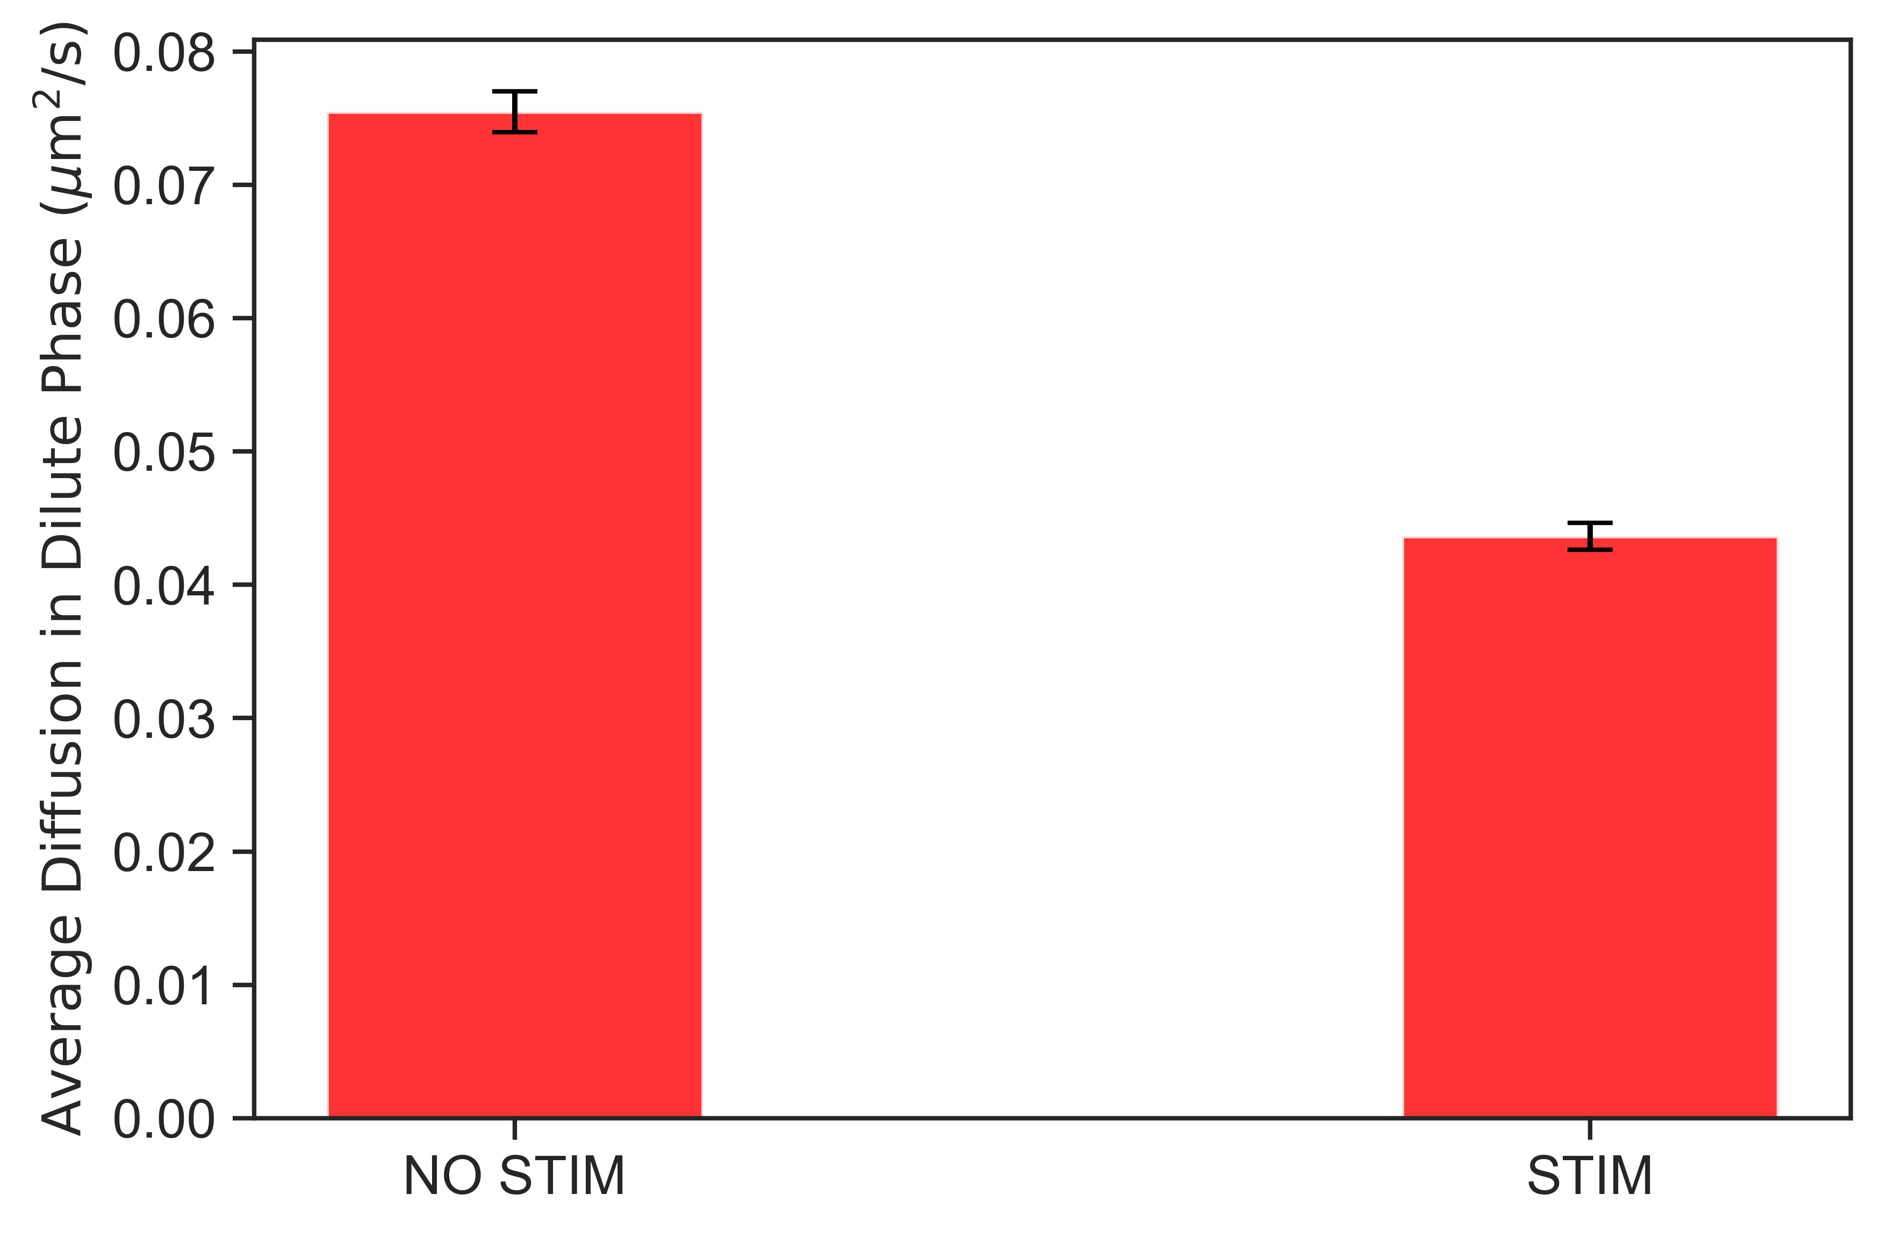
Notes:
Lower binding rate to lipid (0.2x)

Slide 20
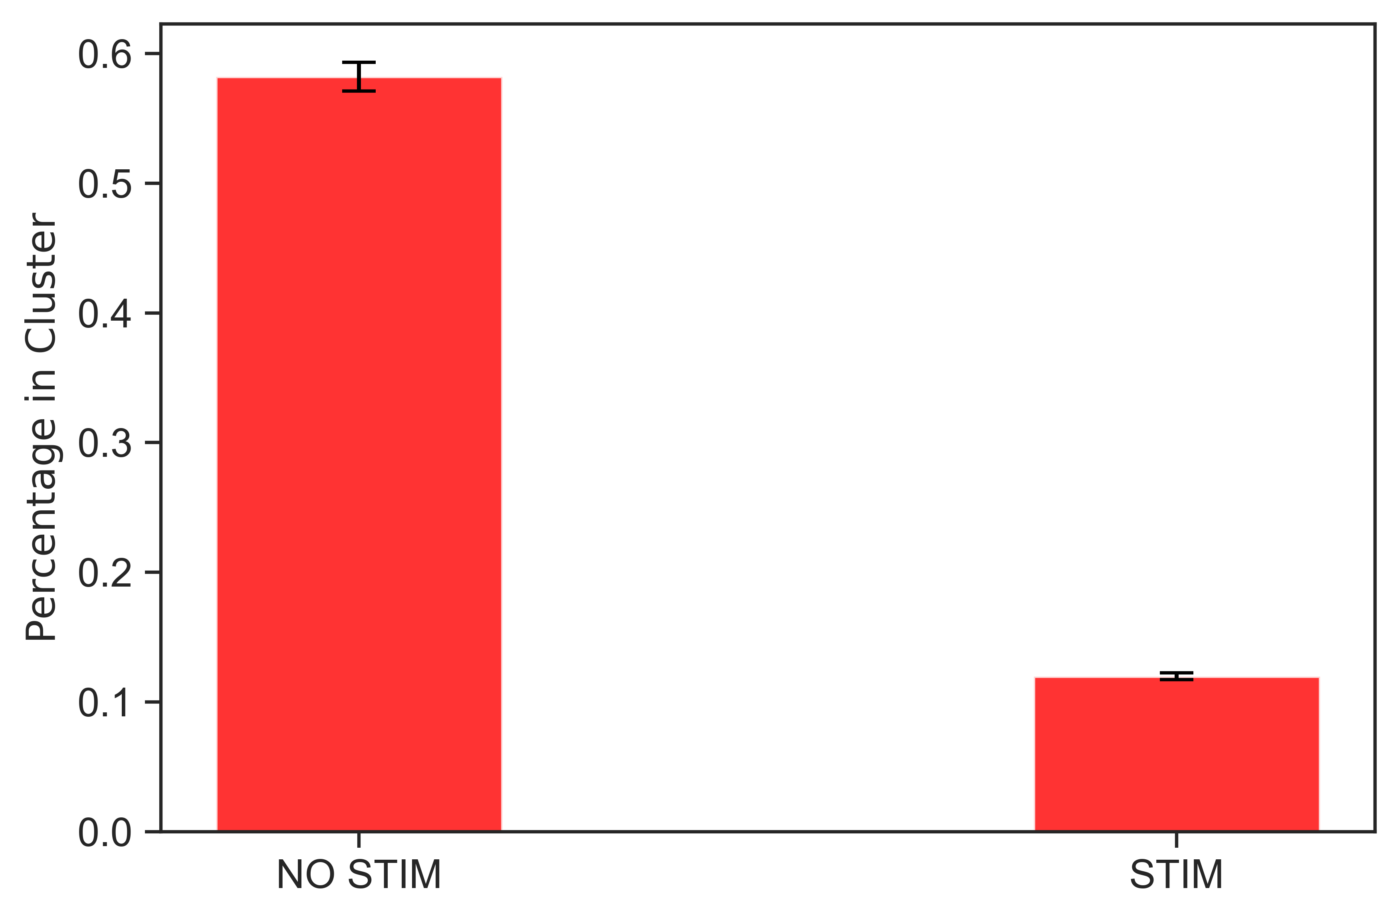
Notes:
Lower binding rate to lipid (0.2x)

Slide 21
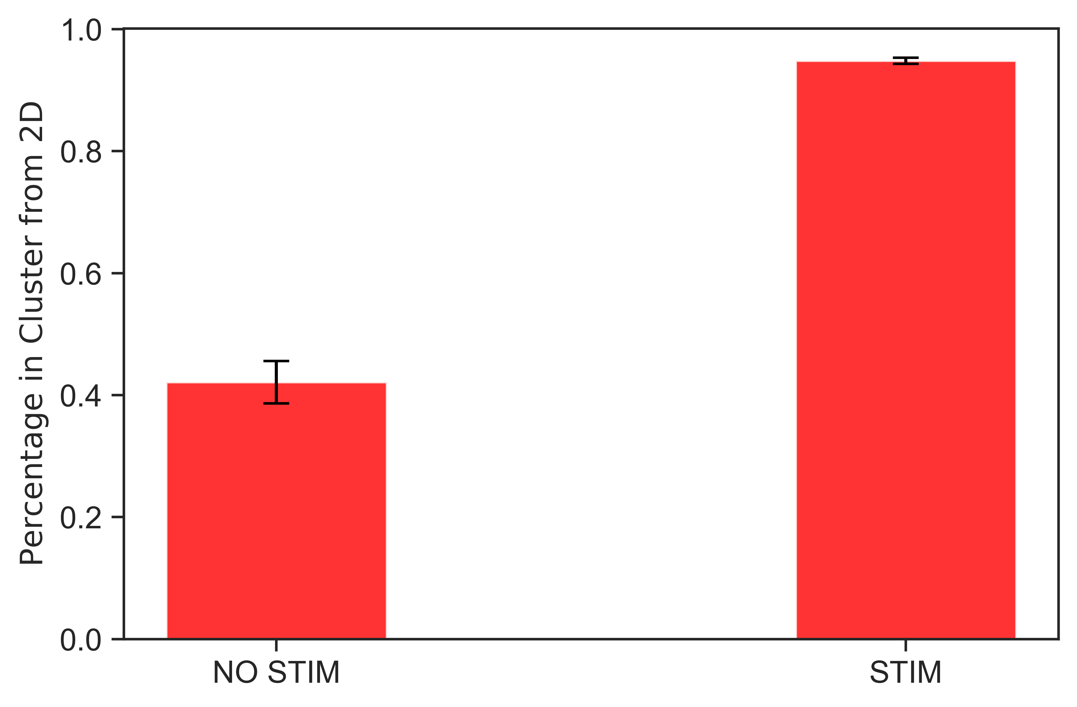
Notes:
Lower binding rate to lipid (0.2x)

Slide 22
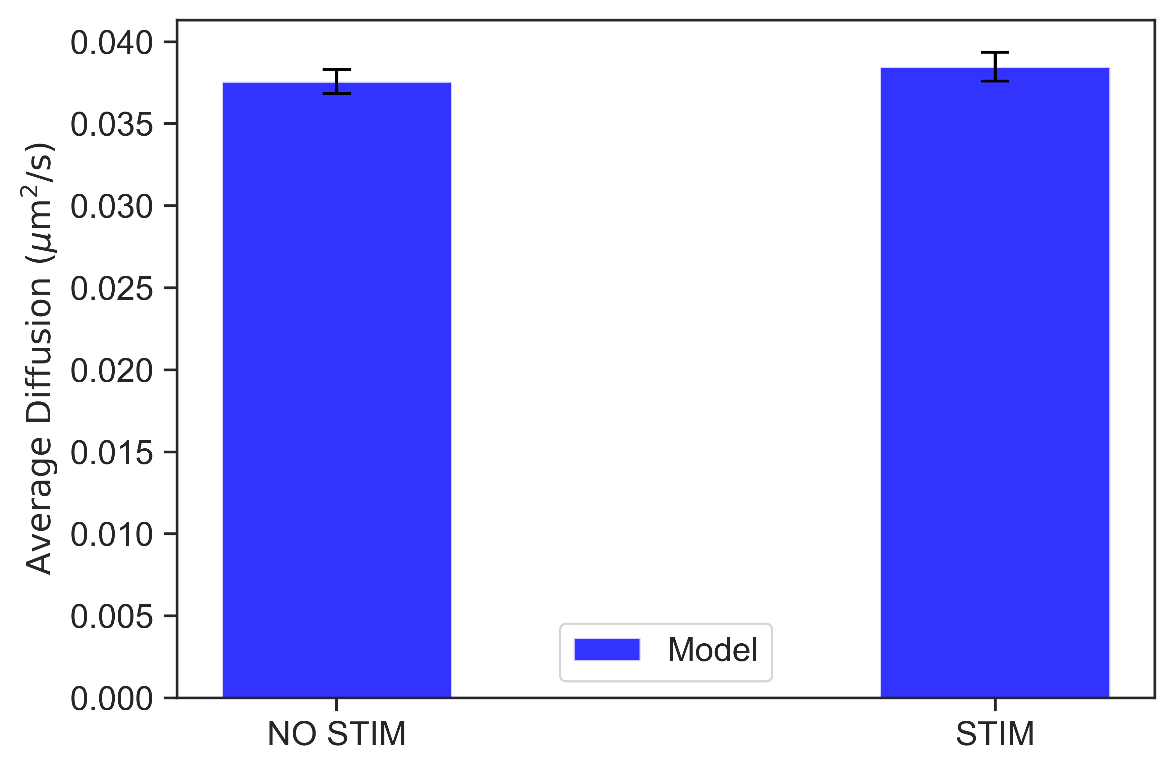
Notes:
0.1x munc conc

Slide 23
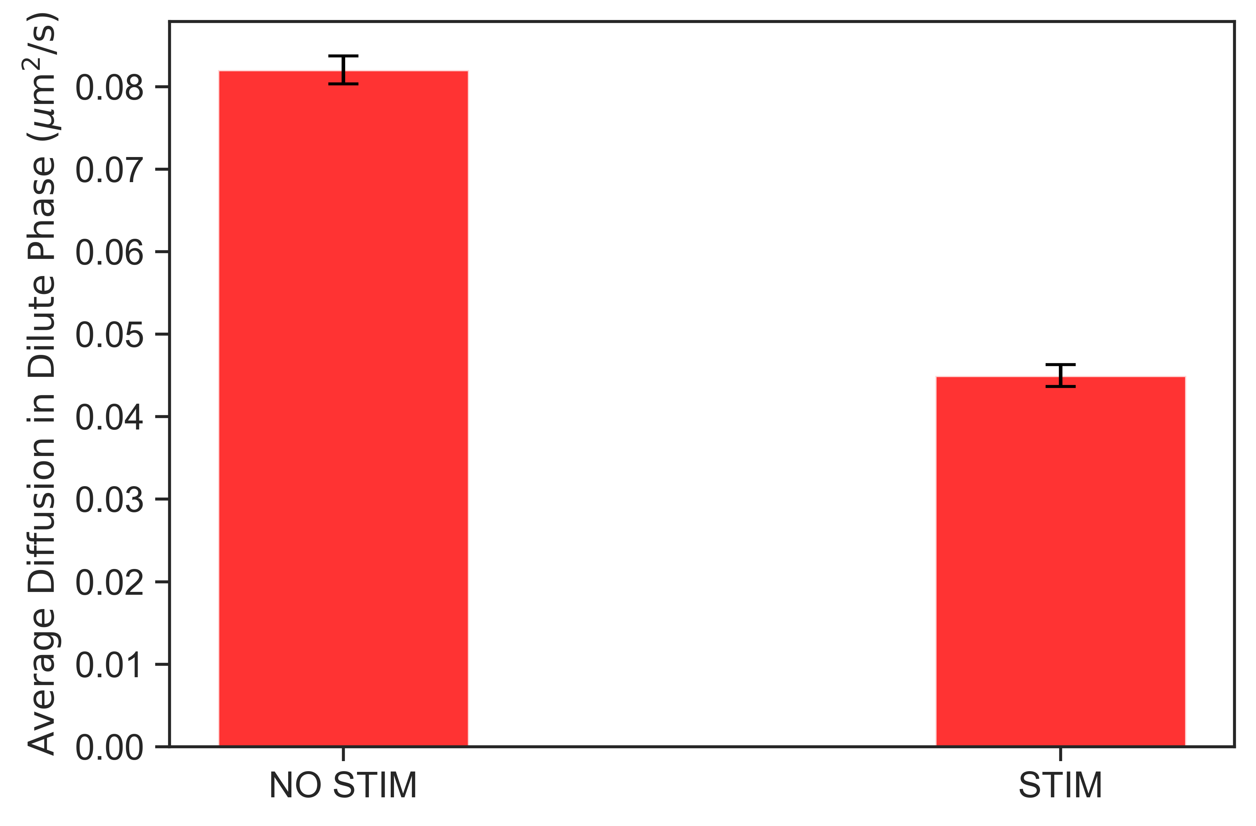

Slide 24
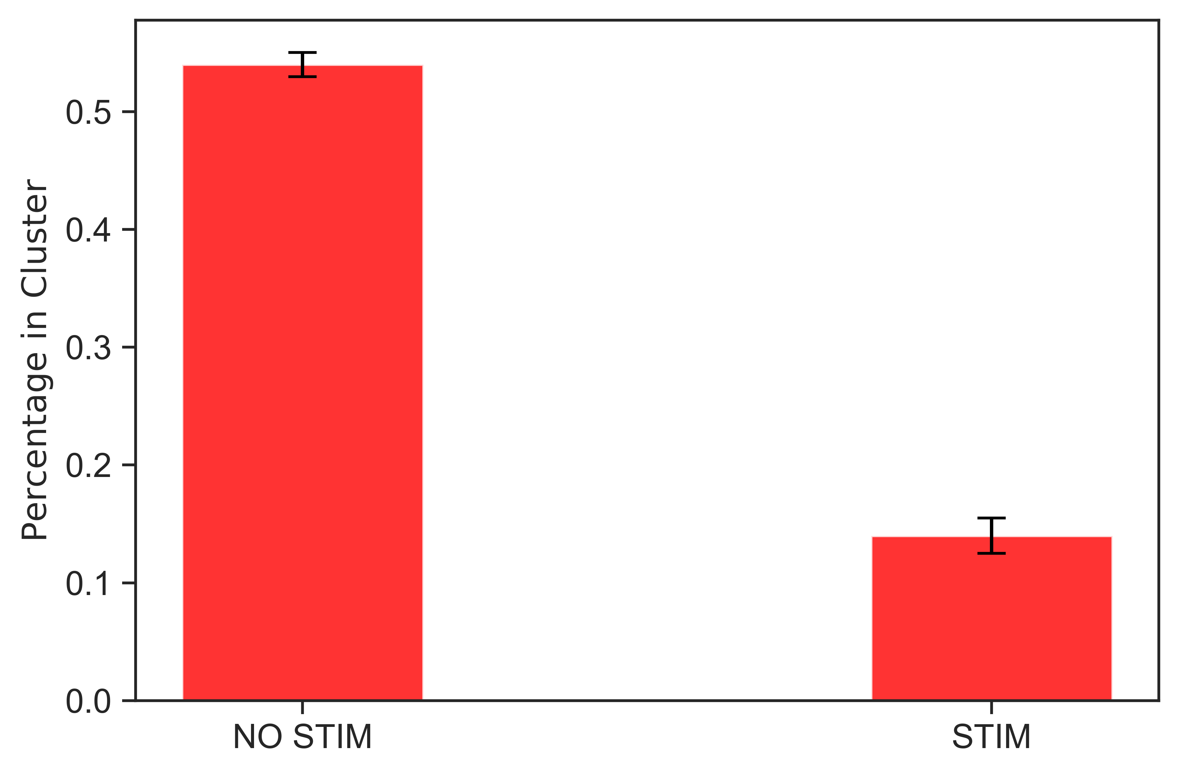

Slide 25
